Slide 1
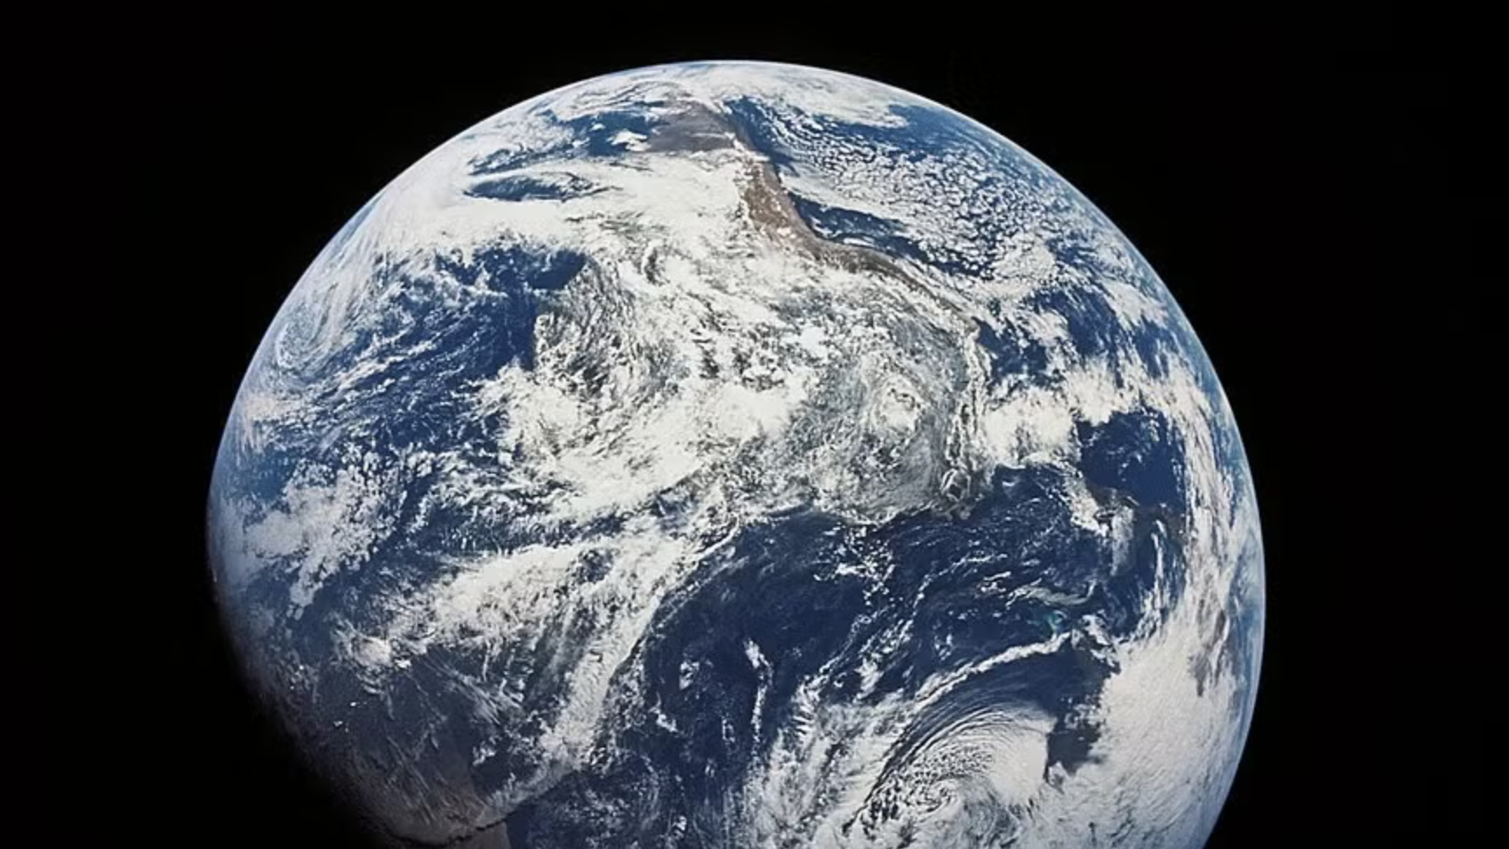
Class 9: Some Basics of Earth Systems Science with Examples
Larry Swatuk
lswatuk@mta.ca

Slide 2
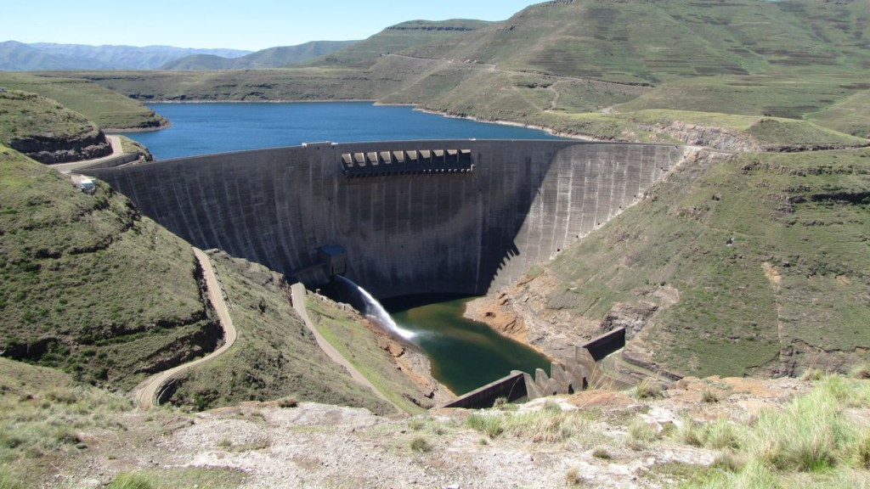
Natural Resource Management
What
A socio-ecological system is an integrated system of ecosystems and human societies that are dynamically linked through reciprocal feedbacks, co-evolution, and shared vulnerability to change
NRM endeavors to manage our interactions with the natural world
Why
Degradation
Pollution
disruption
How
Ecosystems approach

Slide 3
Natural Resource Management as Managing Energy Pathways
The Biosphere is not static ‘things’ -- trees, animals, people, ecosystems -- it is a dynamic flow.
Every living system—from a bacterium to a rainforest to a city—exists only because energy flows through it.
The moment that flow stops, life stops.
Natural resource management, then, is not just about managing stuff. It’s about managing energy pathways, limits, and losses in a finite system

Slide 4
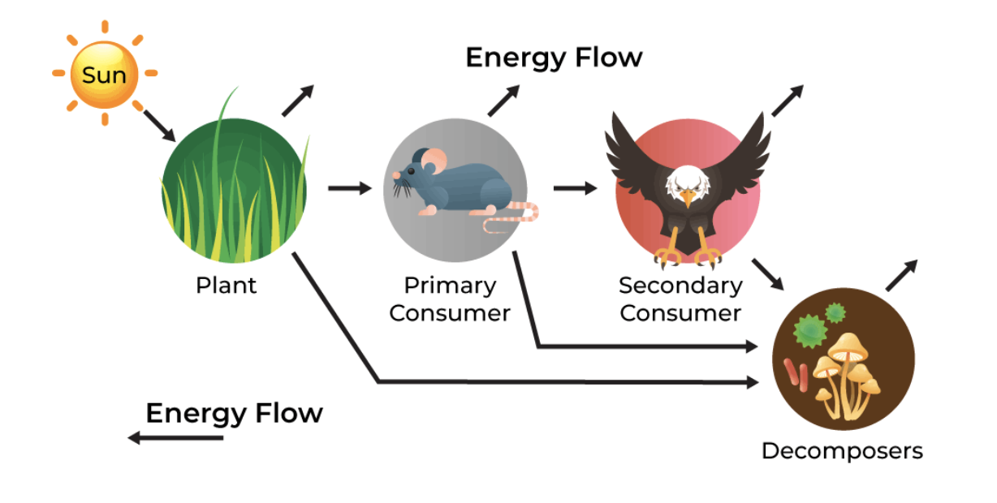
Life as an energy flow
Life on Earth is organized around capturing, transforming and dissipating energy

Slide 5
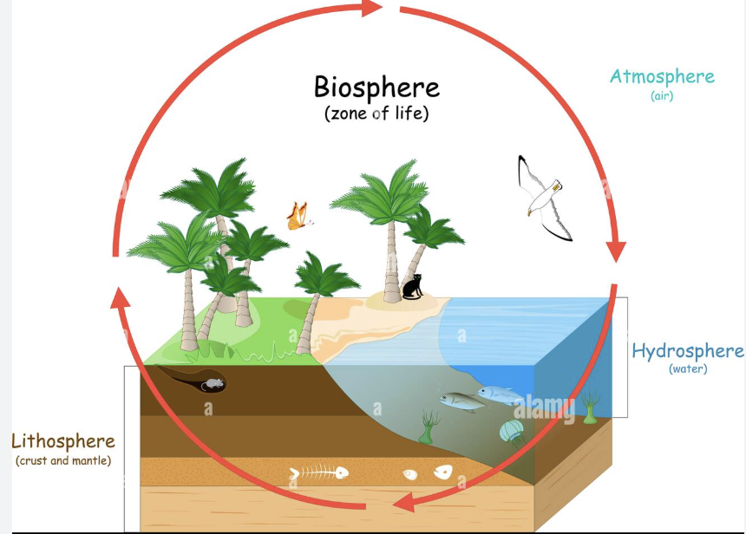
Troposphere
Stratosphere
Mesosphere
Thermosphere
Biosphere (sometimes called the
Ecosphere) represents the zone of
life, including interactions with the
atmosphere, hydrosphere, and
lithosphere.
Cryosphere
(Water in a
frozen state)
Rocks, minerals,
soils that provide
the nutrients
necessary for life

Slide 6
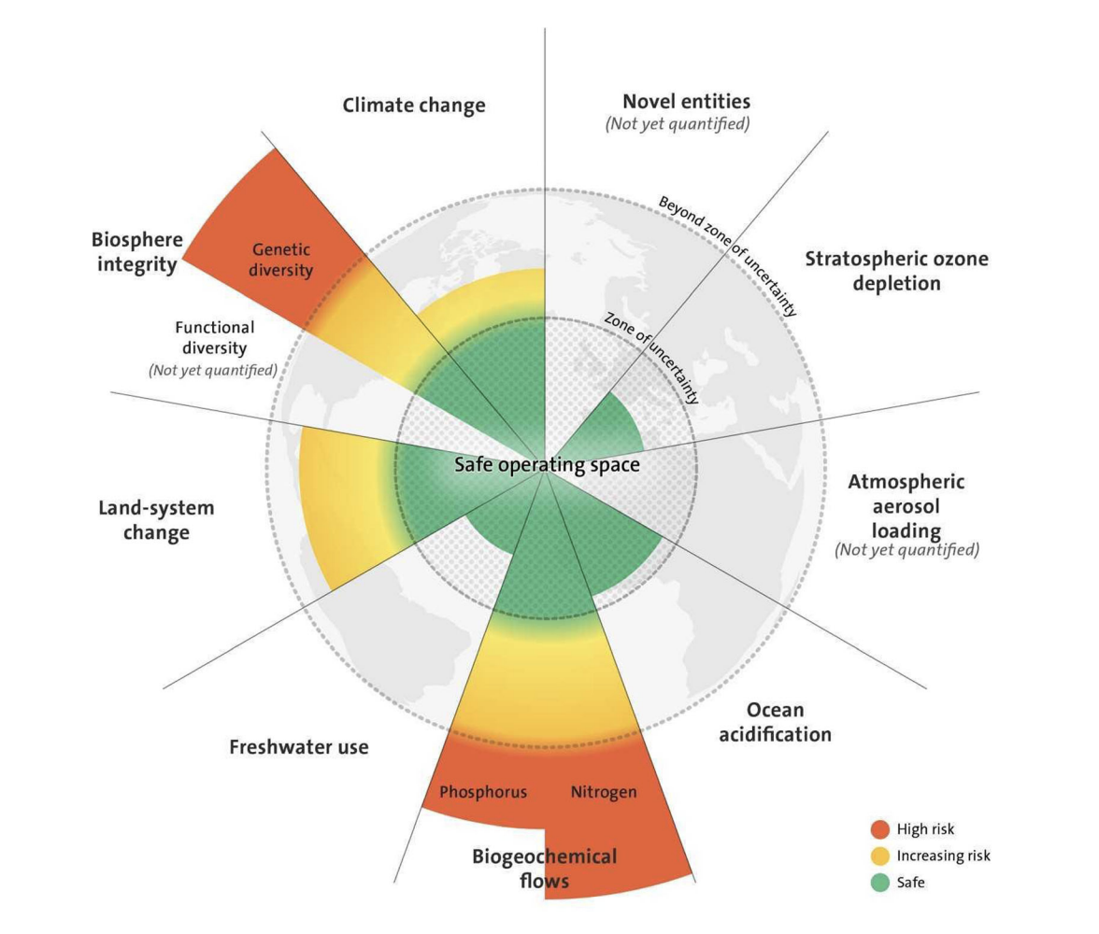
Tipping Points
Life on Earth is a temporary island of order sustained by continuous energy flow—and natural resource management is about deciding how those flows are shaped, shared, and constrained

Slide 7
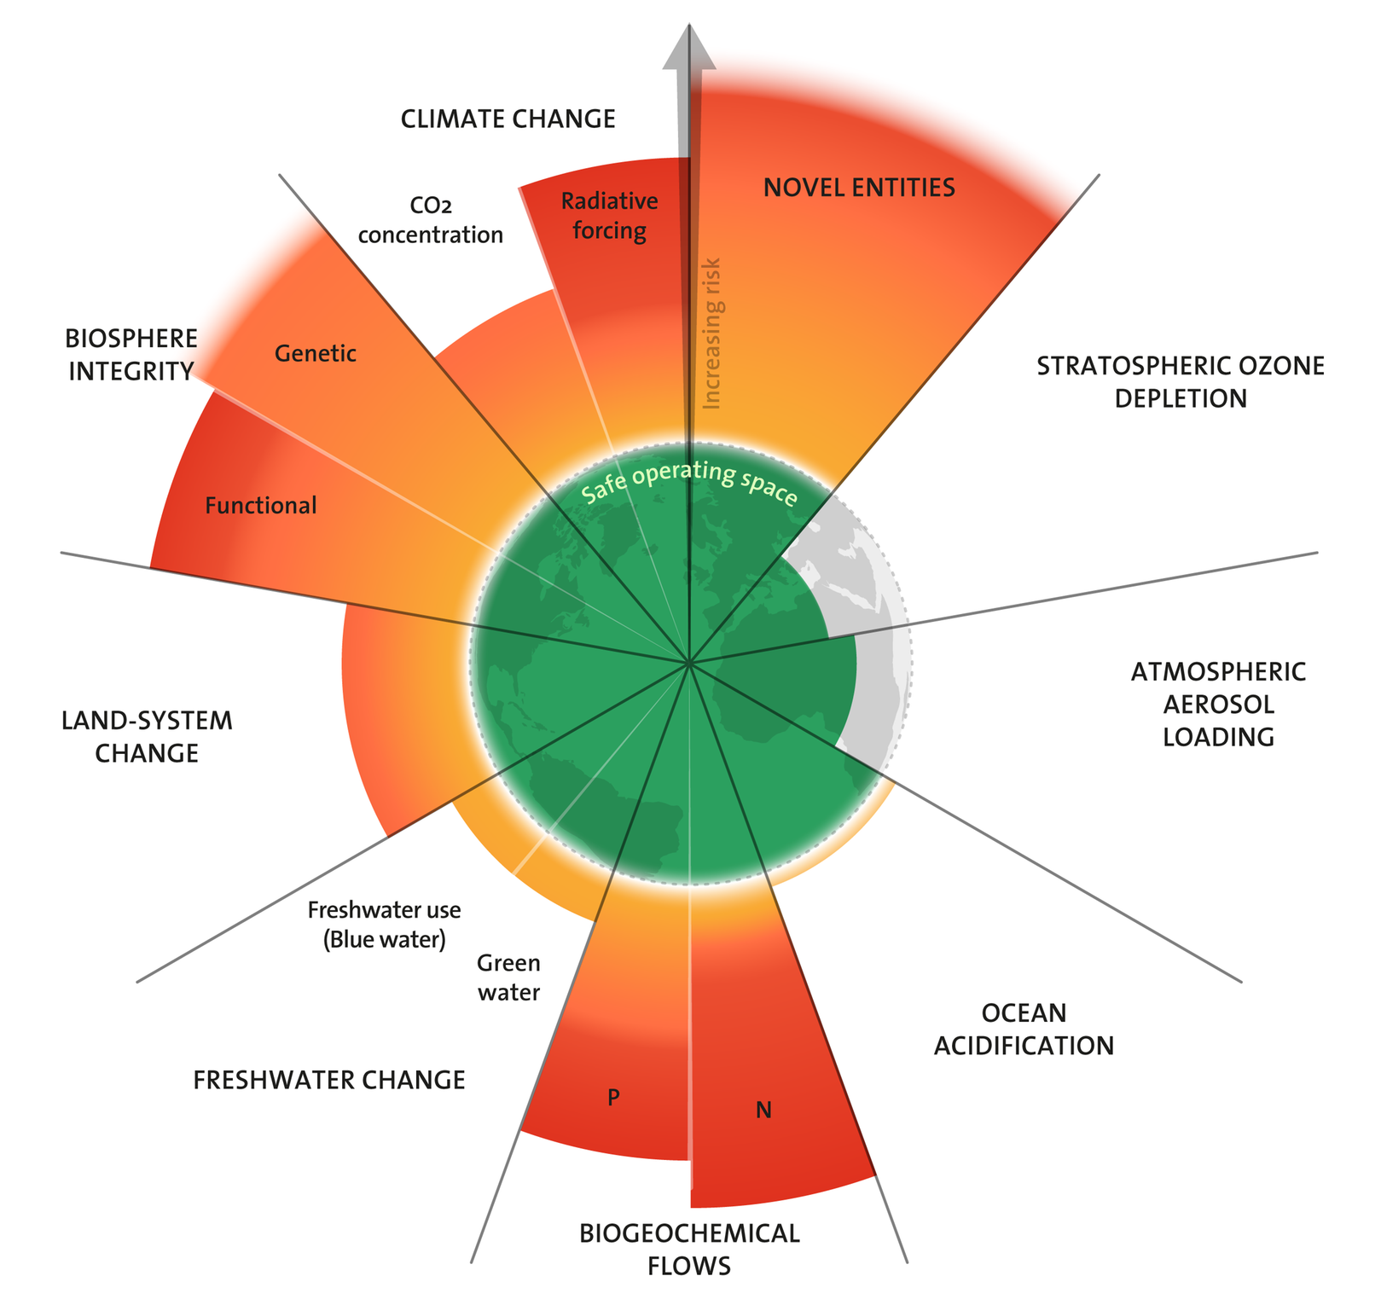
https://www.planetaryhealthcheck.org/#reports-section
Notes:
Novel Entities: Industrial production of artificial chemical compounds for industry, agriculture and consumer goods. Each year, thousands of inadequately tested chemicals, plastics, and other novel entities are released into the environment, and the Planetary Boundary of zero untested entities remains persistently breached.

Slide 8
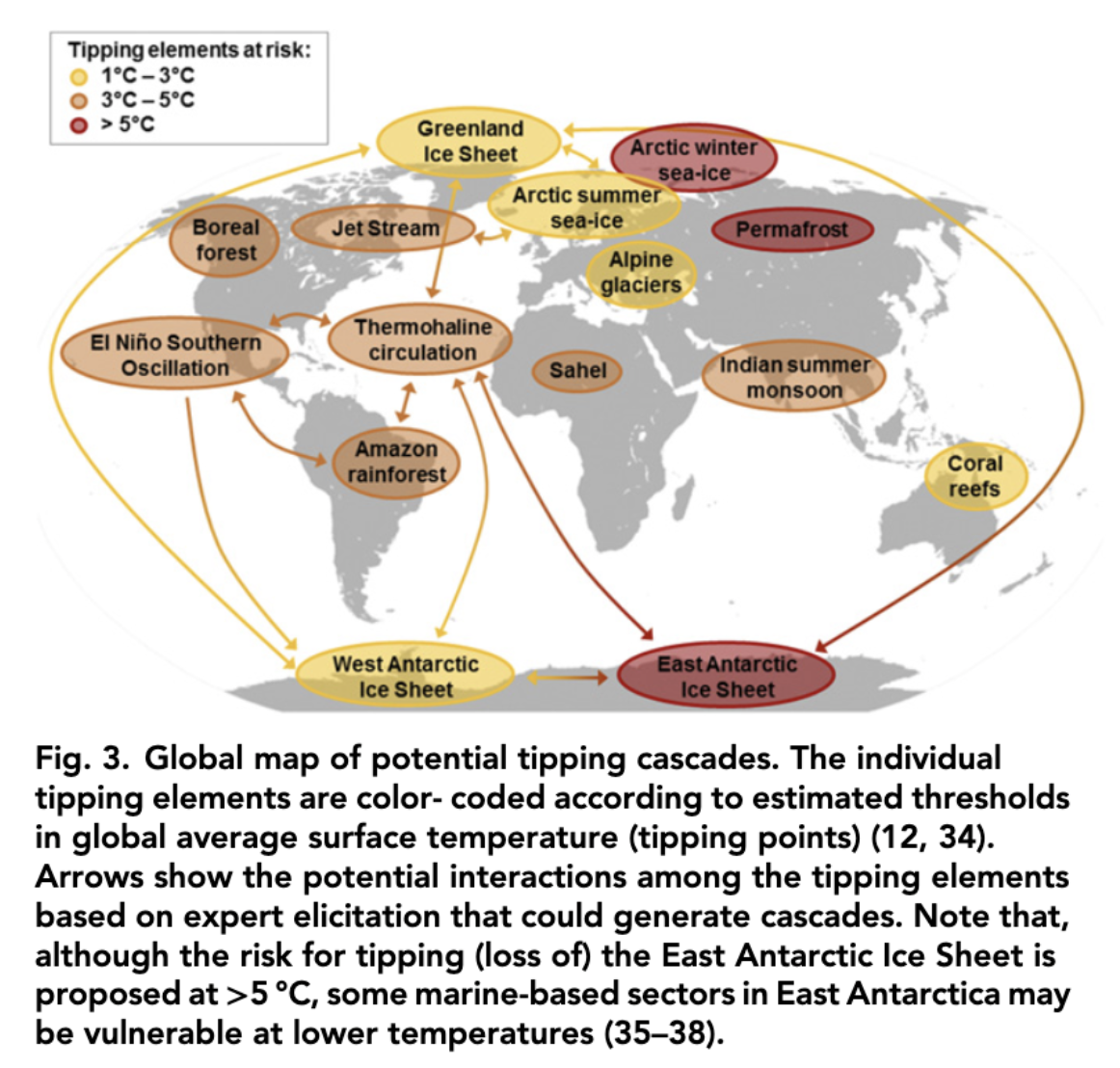

Slide 9
From the Holocene to the Anthropocene?
The Anthropocene is not just about humans changing the Earth—it’s about humans rerouting planetary energy flows.
Holocene (≈ last 11,700 years):
Energy flows dominated by:
solar energy
photosynthesis
slow biological and geochemical cycles
Human societies mostly lived within existing energy flows
Anthropocene (≈ mid-20th century onward):
Humans unlock stored ancient energy (fossil fuels)
Energy flow through society increases orders of magnitude
We overwhelm natural sinks:
atmosphere (climate change)
oceans (acidification)
ecosystems (biodiversity loss)

Slide 10
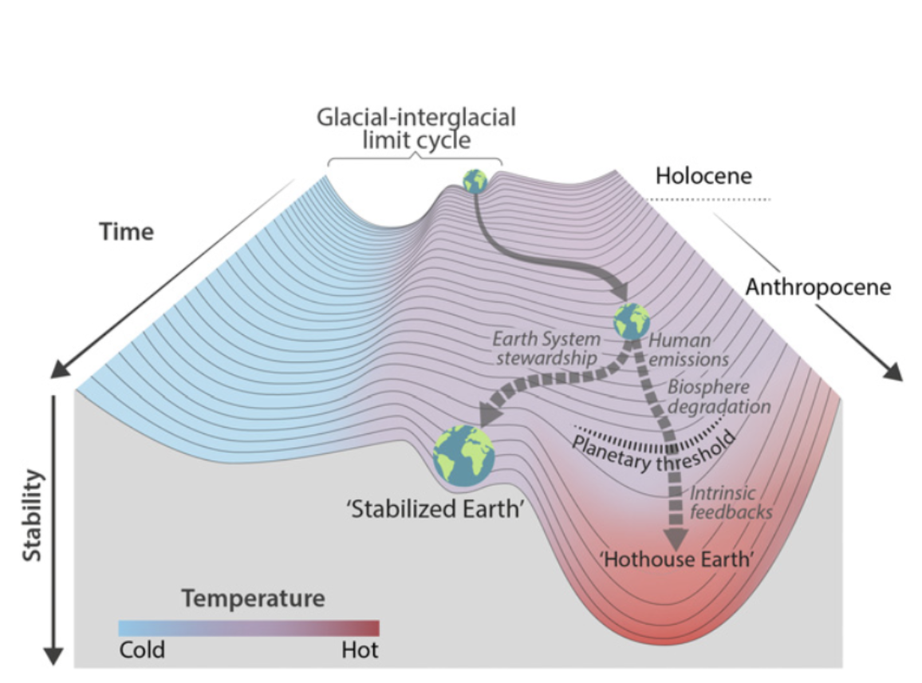
In search of a ‘stability pathway’

Slide 11
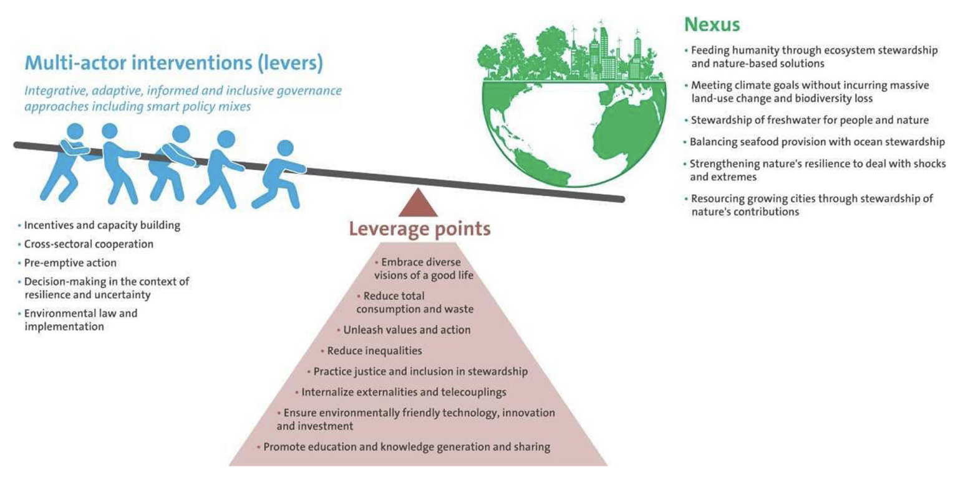
Notes:
Folke, C., S. Polasky, J. Rockstrom … B.H. Walker, 2021. Our future in the Anthropocene biosphere. Ambio 50: 834-869.

Slide 12
Life as energy flow
Life on Earth is organized around capturing, transforming and dissipating energy
Life exists because of energy flow, not energy storage
From a physics perspective, Earth is an open system:
Energy in: mostly solar radiation
Energy out: heat radiated to space
Living systems don’t create energy and they don’t keep it for long—they channel it. The moment energy stops flowing, life stops. A forest, a bacterium, or a human body is not a thing so much as a process sustained by throughput.
This aligns perfectly with the first law of thermodynamics: energy is conserved, but it changes form as it moves through living systems.

Slide 13
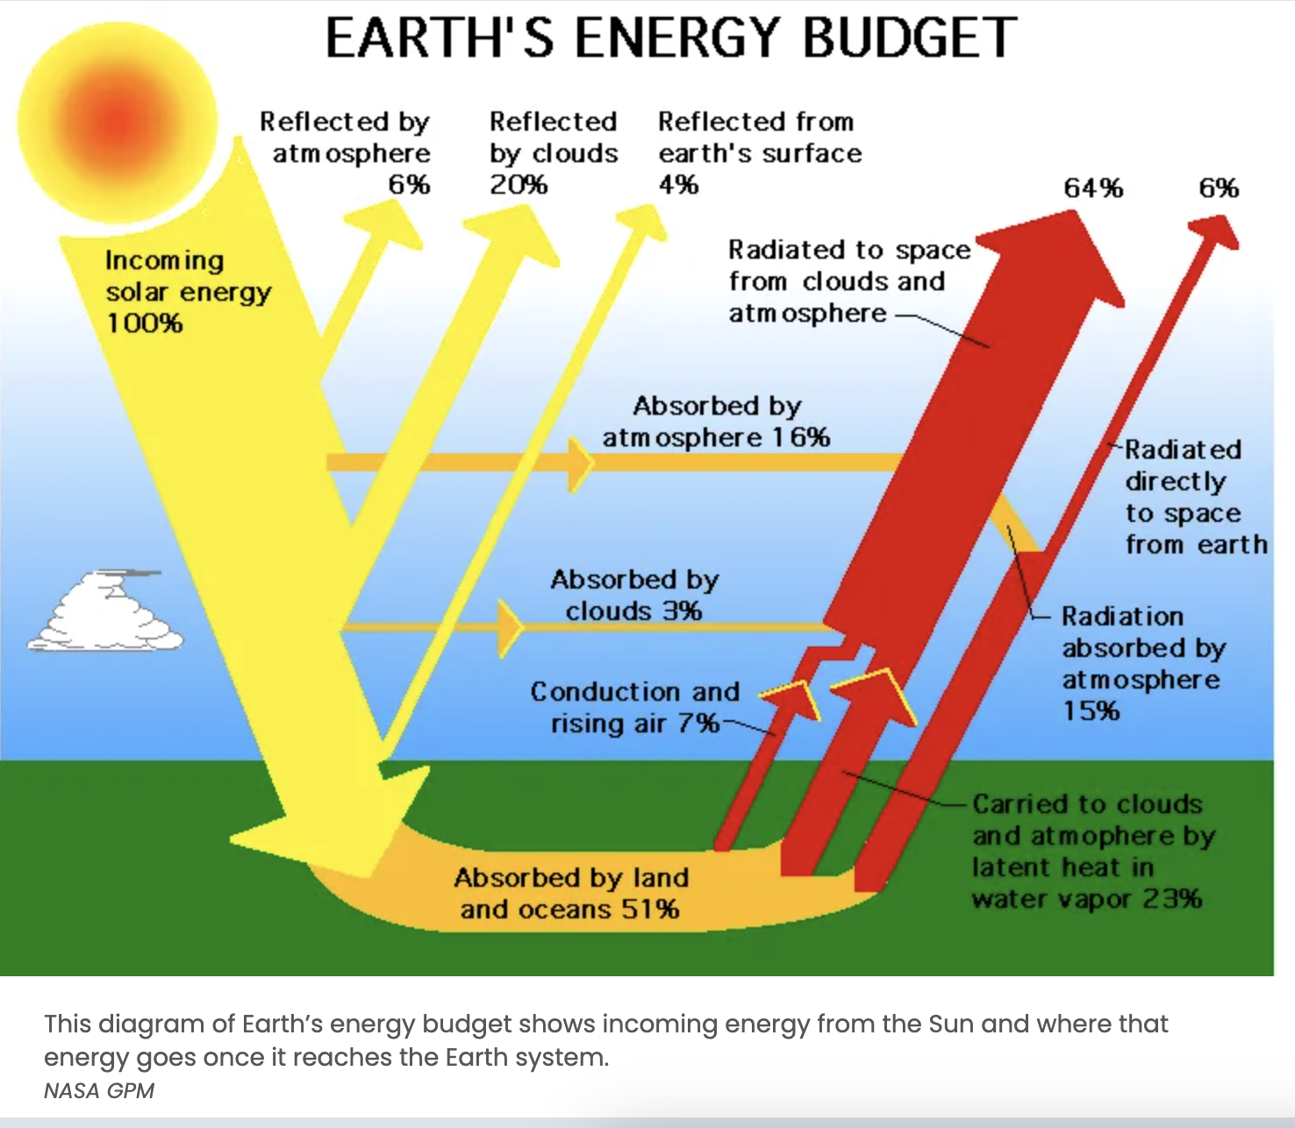

Slide 14
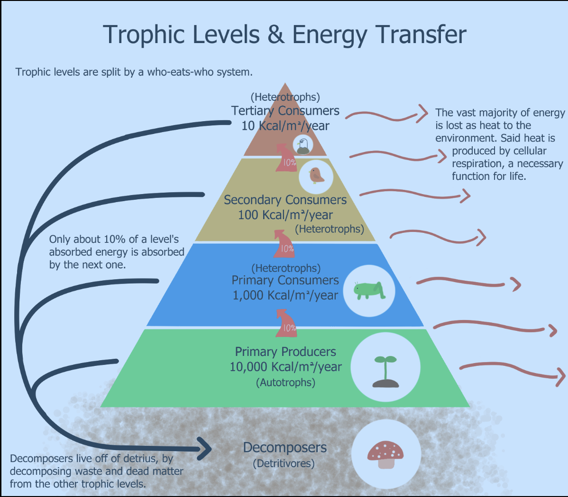

Slide 15
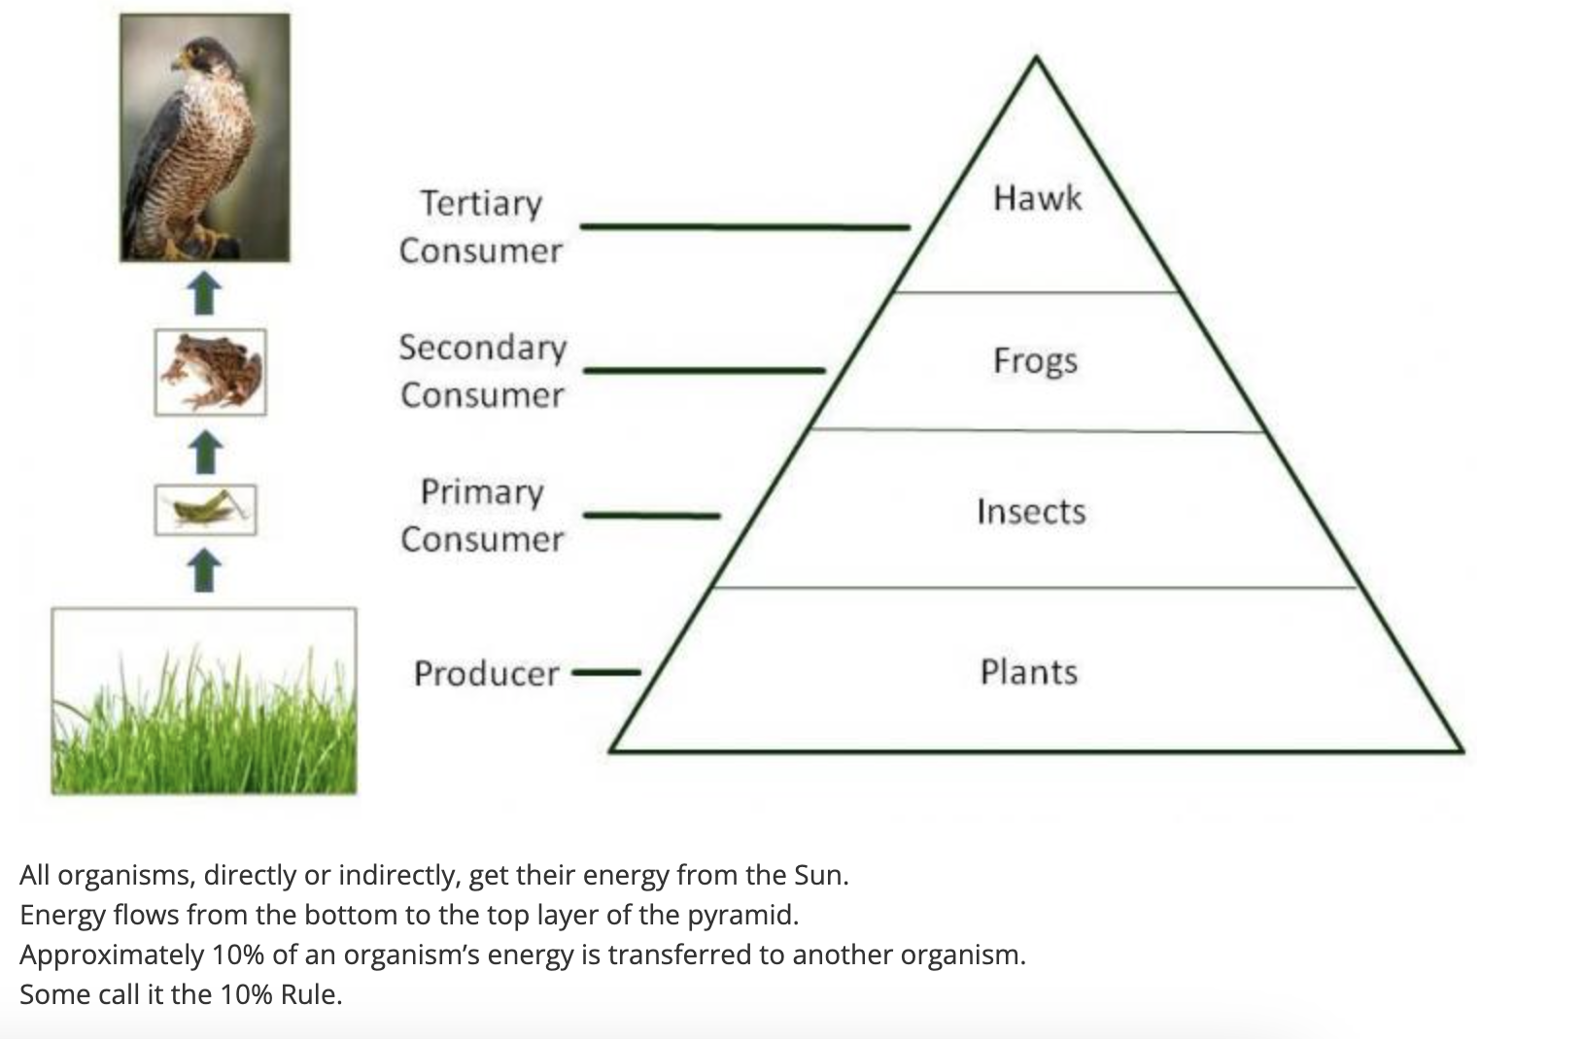

Slide 16
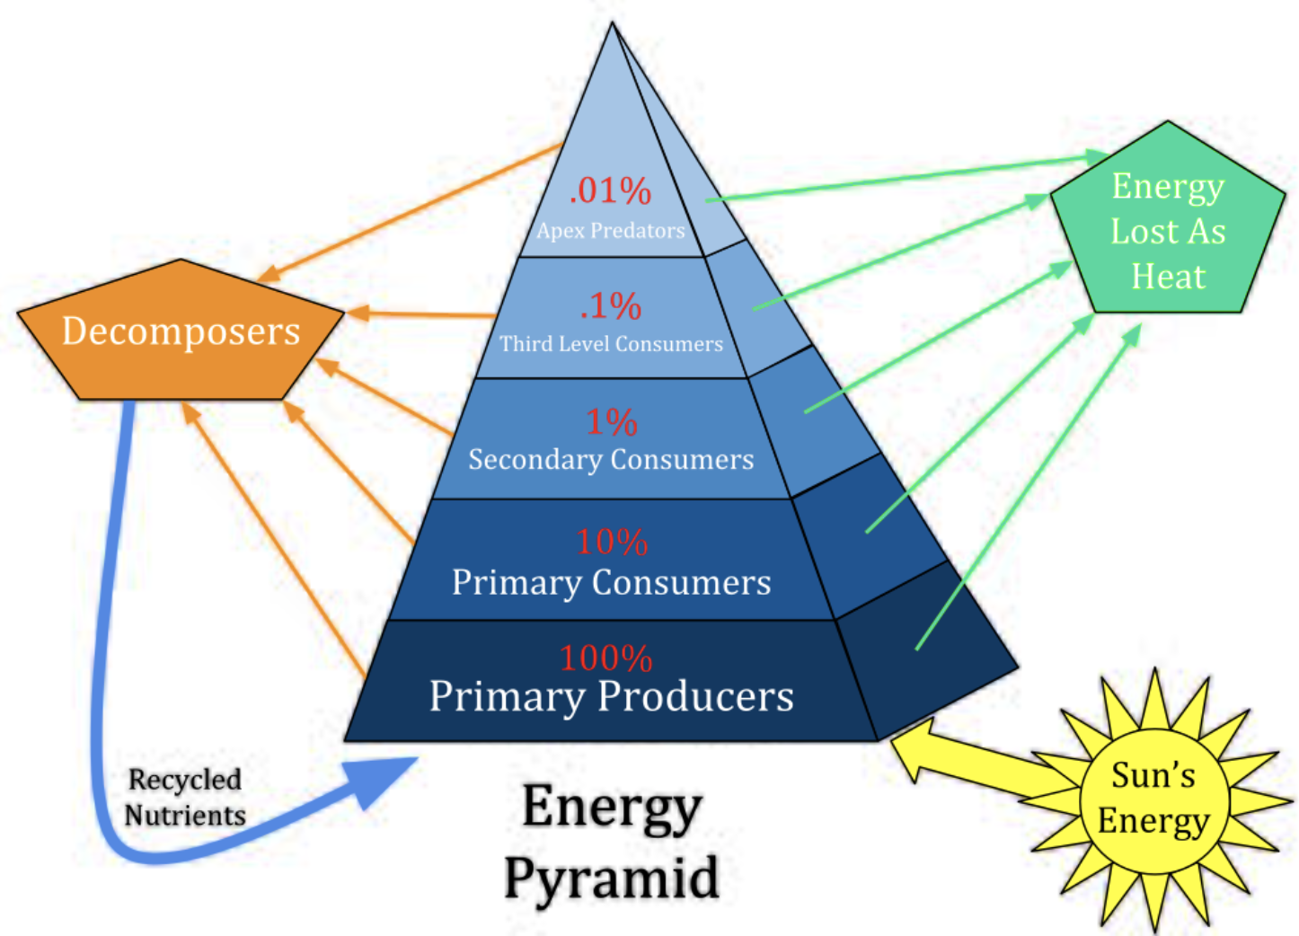

Slide 17
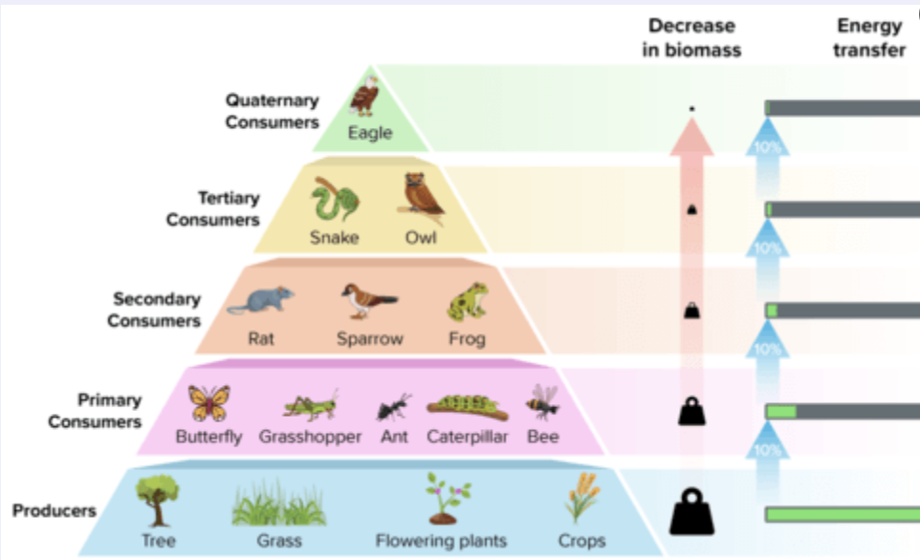

Slide 18
Biology is basically energy conversion with rules
At every level:
Photosynthesis converts solar energy into chemical energy
Metabolism converts chemical energy into work and heat
Food webs transfer energy from producers → consumers → decomposers
Ecosystems lose energy at each step as waste heat
Only a small fraction of energy moves “up” each trophic level. That’s why:
food chains are short
large predators are rare
ecosystems have characteristic structures
This is the second law of thermodynamics in action: every energy transfer increases entropy.

Slide 19
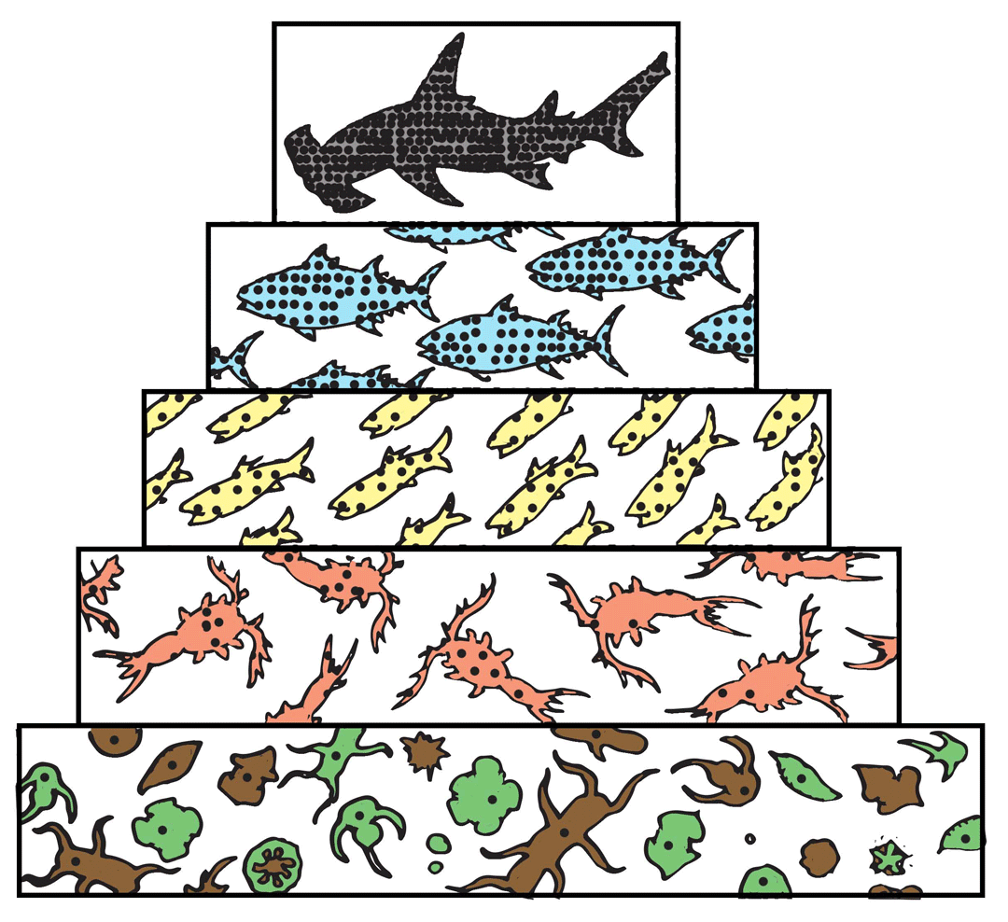
Mercury Pollution
Biomagnification
Bioaccumulation

Slide 20


